Slide 1
Professional Development LC Class 2: Marketing Yourself With Your Team: Share a possible SMART Goal pertaining to a Leadership Competency
ENGR 4010: Professional Development LC

Slide 2
Video Review
TELL US:
Who would you hire? Why?
Who wouldn’t you hire? Why?
What improvements could the interviewees make?

Slide 3
Are Engineers Leaders?
Notes:
Why was it difficult?
What do you think they were trying to figure out?
What part of a bicyle?; What kitchen utensil?
Really want to know about your resiliency, adaptability.
Trying to get at Leadership Competencies…

Slide 4
Three Orientations to Engineering Leadership: What type of leader are you?
 | Technical Mastery | Collaborative Optimization | Organizational Innovation
Who? | The engineer you most often go to with your technical questions | The engineer who builds high performing teams by bringing out the best in everyone | The engineer whose creative ideas drive the company
Key Features- Influence | Coaches junior and senior engineers; listens to and understands others’ questions; clearly explains complex problems to a range of audiences; “go-to” technical resource for organization | Fosters growth through critical feedback; helps team adapt to change and conflict; inspires and motivates team members; leverages colleagues’ strengths | Anticipates trends and plans strategically; change agent (intrepreneur); establishes start ups (entrepreneur); implements ideas to benefit clients
Job Satisfaction derived from: | Lifelong honing of craft | Extensive professional networks | Realized visions
Notes:
Taken from assigned reading
Ask students to take a moment and reflect on type of leader they may be. Then ask them to share with person next to them. Then ask some students to share and discuss with whole class.

Slide 5
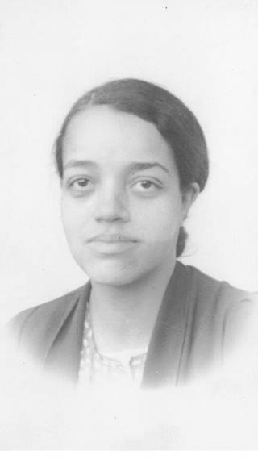
E.G. Dorothy Vaughan
At first driven by Technical Mastery….
Then came Organizational Innovation & Collaborative Optimization

Slide 6
Types of Interview Scenarios
Impromptu Meeting
ZOOM/ Skype/ Webex
Lunch or Dinner
One-on-One Discussion
Panel or Board Review
Tag-Team Discussion
Phone
Notes:
Pose different types to class…
SKYPE?
PHONE?
Drawbacks Vs. Benefits
Control your environment!
You’re interviewing them as well- trust yourself on whether a good fit (argument)
Always focus on questioner but share eye contact with others as well

Slide 7
What was the most difficult question you were ever asked or heard someone was asked in an interview?
Notes:
Why was it difficult?
What do you think they were trying to figure out?
What part of a bicyle?; What kitchen utensil?
Really want to know about your resiliency, adaptability.
Trying to get at Leadership Competencies…

Slide 8

Competency Based Questions
Examples:
“Tell me about a time when …”
“Describe a situation where…”
“Give me an example of…”

Slide 9
Leadership Competencies
Which Leadership Competencies may be easy to talk about?
Which Leadership Competencies may be difficult to talk about?

Slide 10
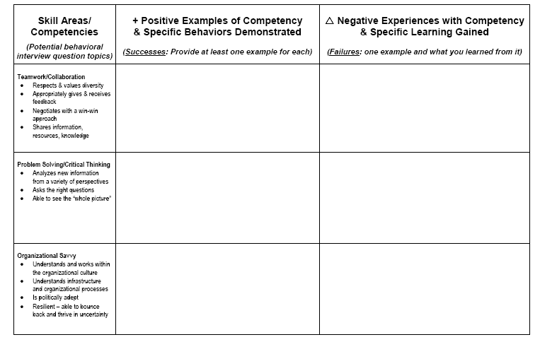
Leadership Competency Matrix

Slide 11
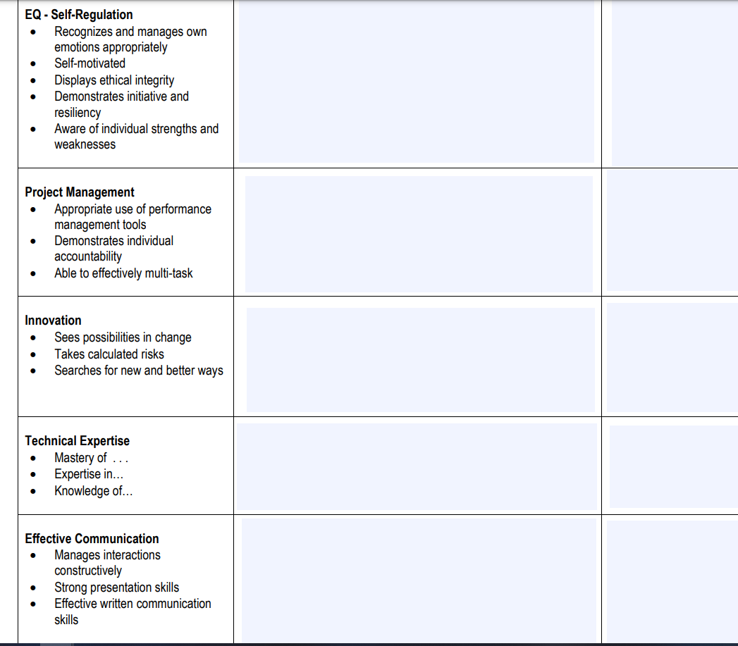
Leadership Competency Matrix

Slide 12
S.T.A.R. Response
Situation/Task
Give an example of a situation you faced or task you were given.
Action
What did you do? What action did you take? Be specific.
Result
What happened as a result of your action?

Slide 13
Overview of Individual Presentation Assignment
Select a Scenario (Job interview, discussion w/ supervisor, grad interview etc.)
Build a Backdrop for your scenario. This sets the stage, i.e. type of company, work environment, relationship, etc.
Give backdrop to interview group (1-2 minutes)
Deliver 60 – 90 second sell
Get verbal/written feedback from peers
Write self-reflection and plan
Notes:
Hand out assignment sheet

Slide 14
Practice & Criteria:
Evaluating Responses
Was a STAR response used?
Did response address the desired competency?
Did the response share insights gained?
Were described actions appropriate to the situation?
Would you hire this individual?
High-Potential player? Why/why not?
Consider verbal & non-verbal delivery!
“Reflecting on your experiences, what Leadership Competencies would you look to improve in the coming year?”
Notes:
Especially important to pay attention to when providing feedback for 60 second sells

Slide 15
The Intro
Opening statement should help listener to know your goal and purpose
Should be clear and concise
Use some sort of “hook” to gain attention
Leaves listener wanting more

Slide 16
The Main Body (Use Personal Format or S.T.A.R.)
Personal Format
Your Skill: an ability to do an activity or job
Your Knowledge: an understanding of information on subject gained from experience and or study
Your Experience (s): The process of getting knowledge or skill that is obtained from doing, seeing or feeling.
Your Personal Qualities: a characteristic or feature of someone or something.

Slide 17
Closing or Conclusion
Summarize your main points highlight the
take-a-ways
It should be clear that you are coming to an end, “In Conclusion…”
Be clear about future action items you will take or would like to request from the interviewer
Leave strong professional impression
Thank the interviewer

Slide 18
Tips for Building Your Sell
Write down your goal
Target your pitch to a specific audience
Use words that create a visual image
Be clear and concise
Tell a good (short) story about yourself
Record yourself in advance
Practice for an audience

Slide 19
LC Reflection & Development Plan- Due 7/24, 11:59PM via LMS
Which LC’s are strengths for you? Which LC’s could be areas for improvement?
Did you showcase LC’s during your Sell/Q. Answers?
2 SMART Goals for improving specific LC’s
4 Specific action steps-
1 for each SMART Goal
2 for improving 60 Second Sell/pitch
Make sure to include timeline
Peer Feedback Examples
See Rubric/Instructions

Slide 20
For Next Class
Individual Presentation Assignment
Wear interview-appropriate attire (what you might wear to an interview), if able.
We will all meet in the class Webex Team space and then move into our team breakout for the presentations. 60 second sells will be presented virtually.

Slide 21
Group Activity #1- Describing Yourself
Utilizing the Engineering Leadership article:
Determine which orientation most suits you and then briefly explain it to your group members.
Drawing on your 60 second sell/ career fair/ other interviewing experiences, do you feel you have clearly conveyed your leadership orientation during previous interviews/networking opportunities?
How could you improve?

Slide 22
Group Activity #2- Tip Sheet
Share either interview experiences you have already had with one another and/or search online for different types of interview experiences.
Produce a tip sheet (some do’s and don’ts) for someone who would be going to that type of interview.
Feel free to discuss multiple interview opportunities and types.
*Upload your team’s completed tip sheet to the General Webex Teams space for our class prior to our next class meeting on 7/17*

Slide 23
Group Activity #3- Option 1- Pitch Practice
Take 5-8 minutes to review the draft of your sell or complete a draft of your sell before you beginning practicing as a group
Each member of the group will practice their sell, not exceeding 2 minutes. Be sure someone is timing each person as they practice.
Team members should provide at least 1 minute of feedback after each person presents - what did they do well? What could they improve on?
If there is any time remaining, you can practice competency-based interview questions with one another. Next week's 60 Second Sell presentation assignment will involve both the 60 second sell and answering two behavior-based interview questions.

Slide 24
Group Assignment #3 – Option 2- Leadership Competencies
Practice answering at least one behavior-based interview question per a teammate concerning one of the Leadership Competencies (LC).
Take turns within your group, having different individuals come up with the questions and ensuring that everyone has a chance to practice answering a question.
Try using the STAR method in your response
Give each other feedback on the effectiveness of your answers
Identify which LC’s you find easiest to showcase and which you find difficult. Provide suggestions to each other on how improvement could be made in difficult areas.

